Slide 1
American Statistical Association Council of Chapters Governing Board 2011 Annual Report of Chapters

Slide 2
Completion of Annual Survey
District | Number of Chapters | Number of 2011 Reports Filed | Percentage of 2011 Reports Filed
1 | 10 | 7 | 70.0
2 | 10 | 10 | 100.0
3 | 13 | 12 | 92.3
4 | 14 | 4 | 28.6
5 | 12 | 8 | 66.7
6 | 14 | 11 | 78.6
Totals | 73 | 52 | 71.2
Table 1. Annual Survey Percent Completed

Slide 3
Chapters Not Completing Survey
District | Chapter
1 | Buffalo-Niagara
1 | Montreal
1 | Ottawa
3 | Princeton-Trenton
4 | Central Arkansas
4 | Central Illinois
4 | Colorado-Wyoming
4 | Iowa
4 | Milwaukee
4 | Northeastern Illinois
4 | Oklahoma
4 | Red River Valley
4 | St. Louis
4 | Twin Cities
5 | Alabama
5 | Austin
5 | Georgia
5 | Houston
6 | Nevada
6 | Snake River
6 | Southern California

Slide 4
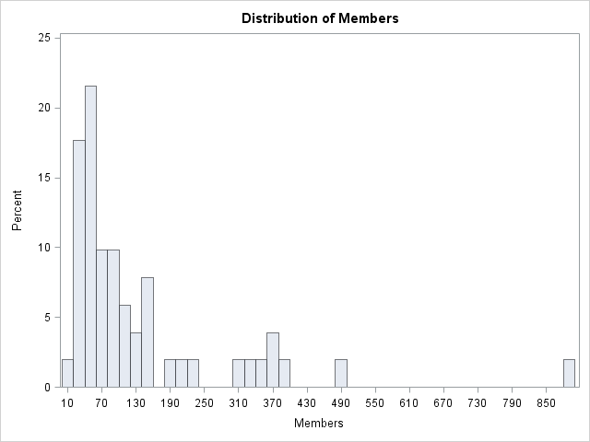
Chapter Size

Slide 5
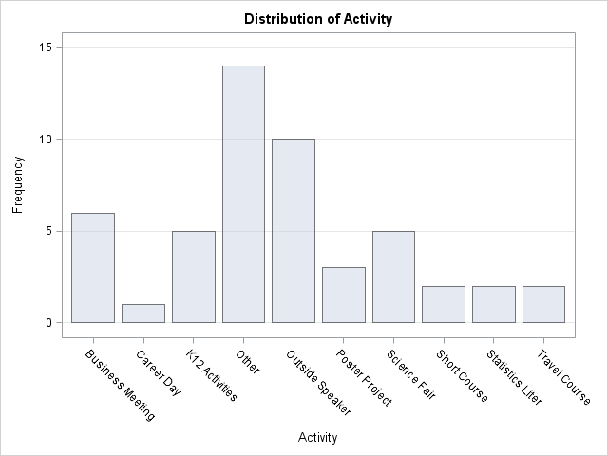
Chapter Activities

Slide 6
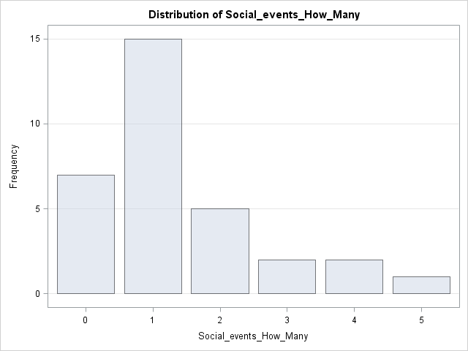
Chapter Social Events

Slide 7
Other Activities
Technical talks from chapter members
Judge high school science fair
Support regional conferences
Student travel support
Awards for best presentations
SIBBS program to promote statistical literacy
Supply Career Day speakers
Award scholarship to statistics students

Slide 8
How can ASA help?
Membership and certification
Members not appearing on ASA member report
Difficulty tracking member dues
Ideas to increase chapter membership
Assistance with statistical literacy efforts
Media
K-12 presentation materials and other assistance
Encourage activities among neighboring chapters

